Slide 1
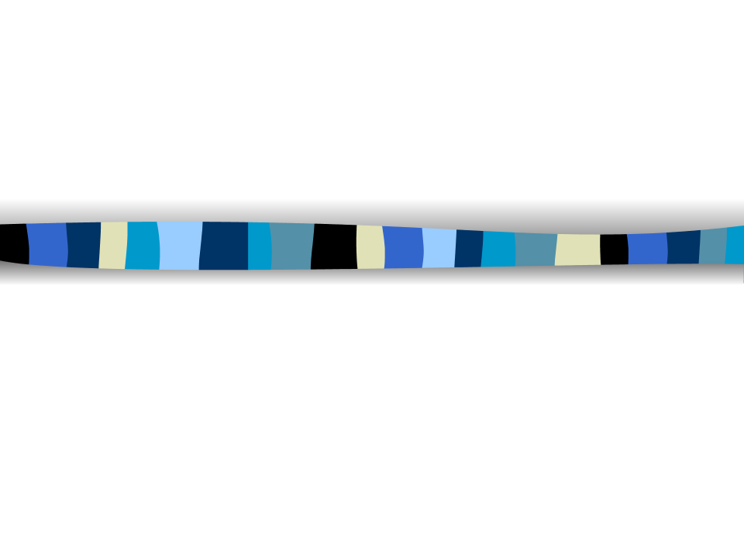

Nutrition Basics
Fruitful Minds

Slide 2


What is
NUTRITION?
How your body gets energy & nutrients from the food you eat

Slide 3
6 Types of Nutrients
  Nutrients we need in big amounts:
  Protein
  Carbohydrates
  Fats
  Nutrients we need in small amounts:
  Vitamins
  Minerals
  Water

Slide 4

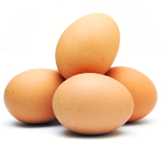
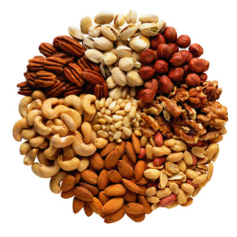
Protein
  Helps body build and repair
  Provides building blocks for
muscle
Sources:
fish, meat, eggs, nuts,
seeds, beans, peas, soy,milk

Slide 5


Carbohydrates
(3 types)
Provides most of our energy:
  Simple sugars
    --fruits, vegetables
2. Starch
  --potatoes, corn, breads
Helps digestion and protects against
heart disease:
3. Dietary fiber
  --wheat bread, vegetables

Slide 6






Carbohydrate Examples
  Healthy carbohydrates:
    Natural sugars in fruits, vegetables
    Dietary fiber
  Less healthy carbohydrates:
    Sugars added to foods
    Table sugar
    Look for: corn sweetener, syrup, high fructose corn syrup, molasses…..

Slide 7

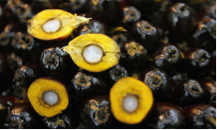
Fats
  Fat serves as energy storage
Unsaturated
- Most of the fat you eat should come from this group
Olive oil, nuts, avocadoes, some types of fish
Saturated
Red meat, butter, cheese, whole milk, palm & coconut oil
Trans
In many processed food
You should have one serving of fat to create a healthy, balanced diet!
Avoid Saturated and Trans fat!
Notes:
Not all bad: Body needs certain types of fat to be healthy

Slide 8
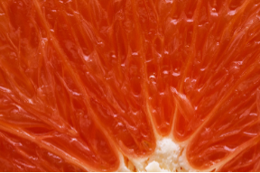
Vitamins
  Help with growth, vision, making healthy bone and teeth, muscle function, water balance
  Example: Vitamin C
    found in citrus fruits
    helps body fight disease
    keeps bones and skin healthy
  Can you think of other examples?
Vitamin A: vision, skin, hair (carrots, cantaloupe, green vegetables, pumpkin, squash)
Vitamin D: healthy bones & teeth (milk, fish, eggs, fortified cereal or milk)
Notes:
Vitamin A: vision, skin (cantaloupe, green vegetables, carrots, pumpkin, squash)
Vitamin B: red blood cells, metabolism (whole grains, fish, poultry, eggs, dairy, leafy green vegetables, beans, peas)
Vitamin D: healthy bones & teeth (milk, fish, eggs, fortified cereal)
Vitamin E: protects body (whole grains, oats, leafy greens, egg yolk, nuts, seeds)
Vitamin K: prevent blood loss when cut, strong bones (leafy green vegetables, dairy, broccoli, soy)

Slide 9
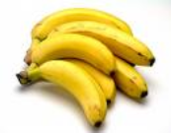



Minerals
  Like vitamins, your body needs minerals to grow and to keep you healthy.
  Examples:
      Calcium: Bones
      Potassium: Nerve and muscle function
      Iron: Helps carry oxygen to cells
      Sodium: Maintains blood pressure

Slide 10

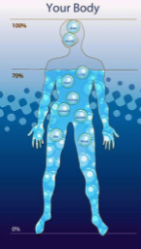


Water *H₂O
Makes up about 70% of body weight
Where is it in the body?
Sources include milk, juice,
fruits, vegetables and water - totalling 6-8 cups per day
We need to drink more when more active or when hot outside

Slide 11
Review
  If you are tired and need energy, what nutrient should you eat? What food groups have these nutrients?
  If your muscles are tired after a soccer game, what nutrient should you eat to repair your muscles? What food groups have these nutrients?
  If you want shiny hair, good vision, and good skin, what nutrient do you need? What food should you eat?
  True or False: Some fats are good for you - if no why? if yes, which ones?

